Slide 1

Data Analysis:
A Very Short Introduction

Slide 2
Learning Data Analytics
1

Slide 3


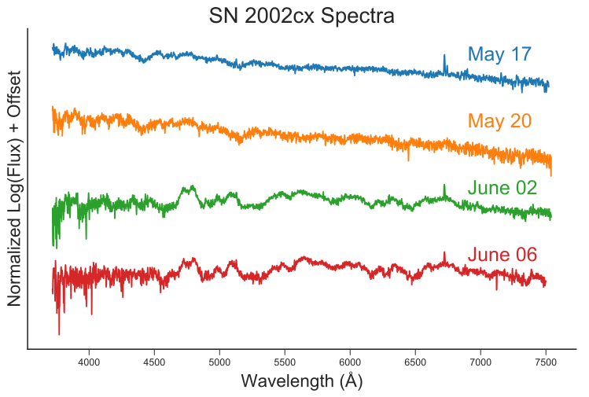





Learning Data Analysis
Learning DA is a bit like learning a new language
Learning vocabulary + grammar (basics)
Reading and Improving (passive skills)
Writing + Talking (active skills)
Interpretation and creation (junior professional)

Slide 4
The Question
2

Slide 5
The Question
Data Analysis always starts with a question. For example:
How can we increase conversion (sales) on our website?
Does washing hands regularly reduce the risk of spreading the flu?
What do we know of our customers, so that we can help them better?
Was Erasmus’ use of Latin influenced by the conversations with his publisher?
How can we improve and optimise our movie recommender system?
How can we optimise crossroad traffic flow in such a way that accidents are reduced?

Slide 6
Where to find the data: Data Access and Storage
3

Slide 7
What (type of) Data?
What type of data do we want?
Depends the question:
e.g. a sales question almost always requires quantitative sales data
Sales questions might also require written data like reviews.
e.g. for predicting stock prices we need stocks data
But we might also want to use language data to gauge investors’ sentiment on Twitter.
Depends on your resources:
Time
Money
Legal resources

Slide 8
Data Storage
Where do we store and find our data?
Online (Global):
Google
Kaggle
WebServers
Local:
Databases (MySQL, MongoDB, ORACLE etc.)
CSV files
Phones
Laptops

Slide 9
Data Accessibility
How accessible is our data?
How sensitive is the data?
Sensitive, personal data
GDRP (General Data Protection Regulation)
Sensitive financial data
Large-scale stock data vs. internal company data
Scientific data
Freely available data vs. data behind paywalls
Do you need to ask for permission or is it ‘open source’?
Web Scraping and APIs
HR data
Paywalls

Slide 10
Cleaning the Data
4

Slide 11
Data Cleaning
Data ‘in the wild’ is usually messy. Cleaning means that we:
‘Fill in the blanks’:
e.g. incomplete employment records.
Want to create meaningful categories:
e.g. from a range of $15.000 to $60.000 we could re-categorise the data into ‘high-income’, ‘middle-income’ and ‘low-income’ categories.
Need to formulate assumptions about the data:
A cleaning procedure will always impact the eventual outcomes. It is important to identify your own assumptions, beware of biases and evaluate the impact a decision might have.

Slide 12
Observation
5

Slide 13
Observation
Because our data set are usually very large, we need to use (statistical) tools to quickly summarise and understand our data.
Descriptive Statistics
What is the mean?
Structure of the data (discrete/cont./mixed?)
How is the data distributed?
Corner cases
Remove outliers?
Focus on the outliers?
Inferential Statistics
Hypothesis testing;
Confidence intervals;

Slide 14
Visualisation
6

Slide 15
Visualisation
In data analytics, we make primarily make visualisations (plots) for two reasons:
We create plots for ourselves to:
Understand the data
Understand anomalies
Identify particular patterns.
We create plots for others to:
Present our findings and communicate our results
Convey a message
Impress our audience :)

Slide 16
The Process: Answering questions using data
7

Slide 17
Answering the question
Question
Answer
Finding Data
Visualisation
Cleaning Data
Observation

Slide 18
Extension: Prediction
8

Slide 19
Prediction
On the basis of historical data, we may decide to build a model that can make predictions for the future.
What can we predict?
Stock prices;
Diseases;
Housing prices;
People’s behaviour;
Behaviour of emergent systems.
Prediction techniques:
Regression;
Classification;
Neural Networks;
Time Series Analysis.

Slide 20
Answering the question
Question
Answer
Finding Data
Prediction
Cleaning Data
Visualisation
Observation

Slide 21
Presentation
9

Slide 22
Presentation
Most of us already know how to present. However, in data analytics, it’s important to keep the following in mind:
What will you leave out, what to leave in?
What is relevant?
Who is your audience?
Academics?;
Fellow data analysts?;
General Public?;
Managers?;
How to present your findings?
Showing your code?;
Focus on the techniques?;
Focus on the intuition?.

Slide 23
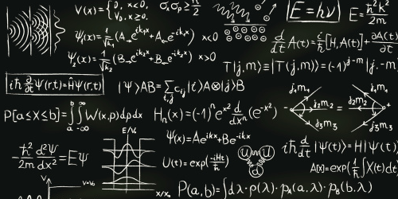
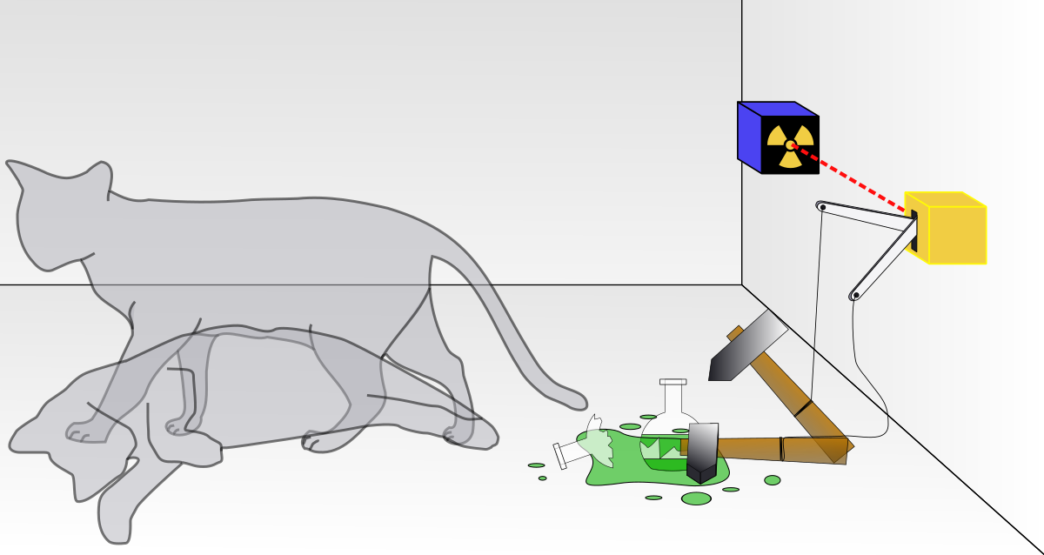
Presentation
vs.
Notes:
Visualisation also helps to identify, and then zoom in to, anomalies – areas where the data does not confirm to our intuitions of relationships.

Slide 24
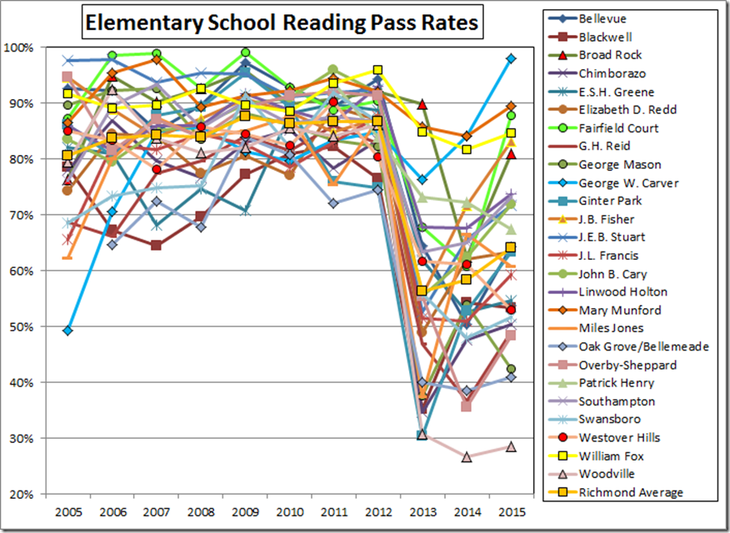
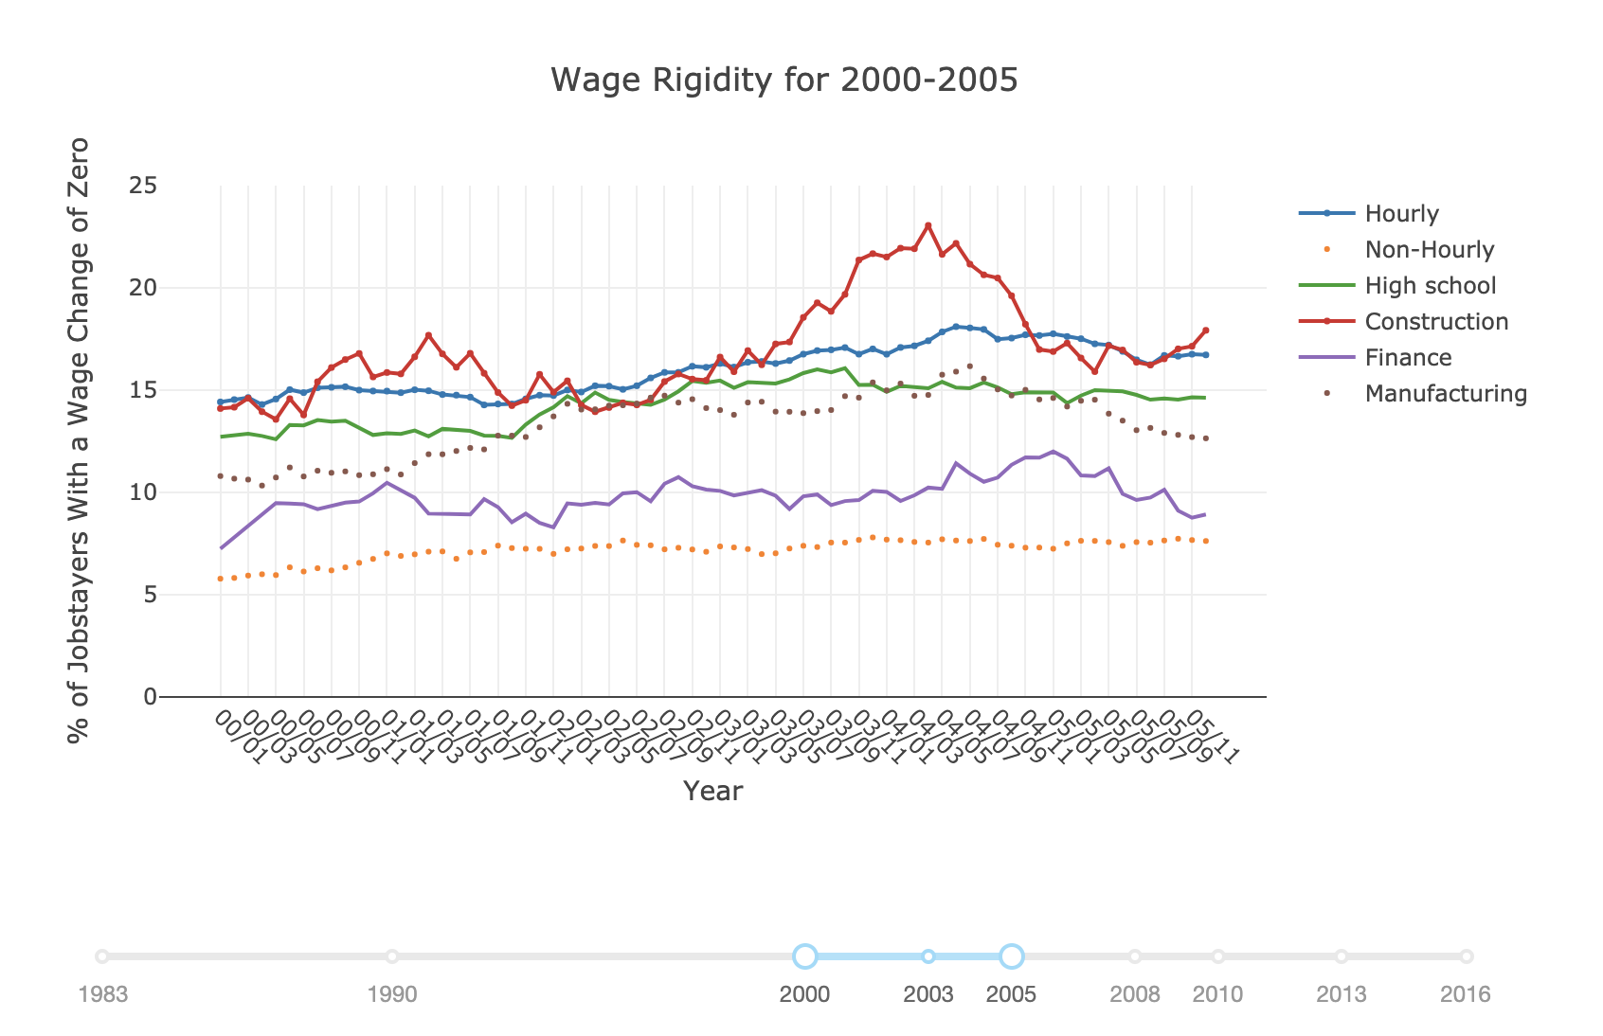
Presentation
vs.
Notes:
Visualisation also helps to identify, and then zoom in to, anomalies – areas where the data does not confirm to our intuitions of relationships.

Slide 25
The End. Let’s Begin!

